Slide 1
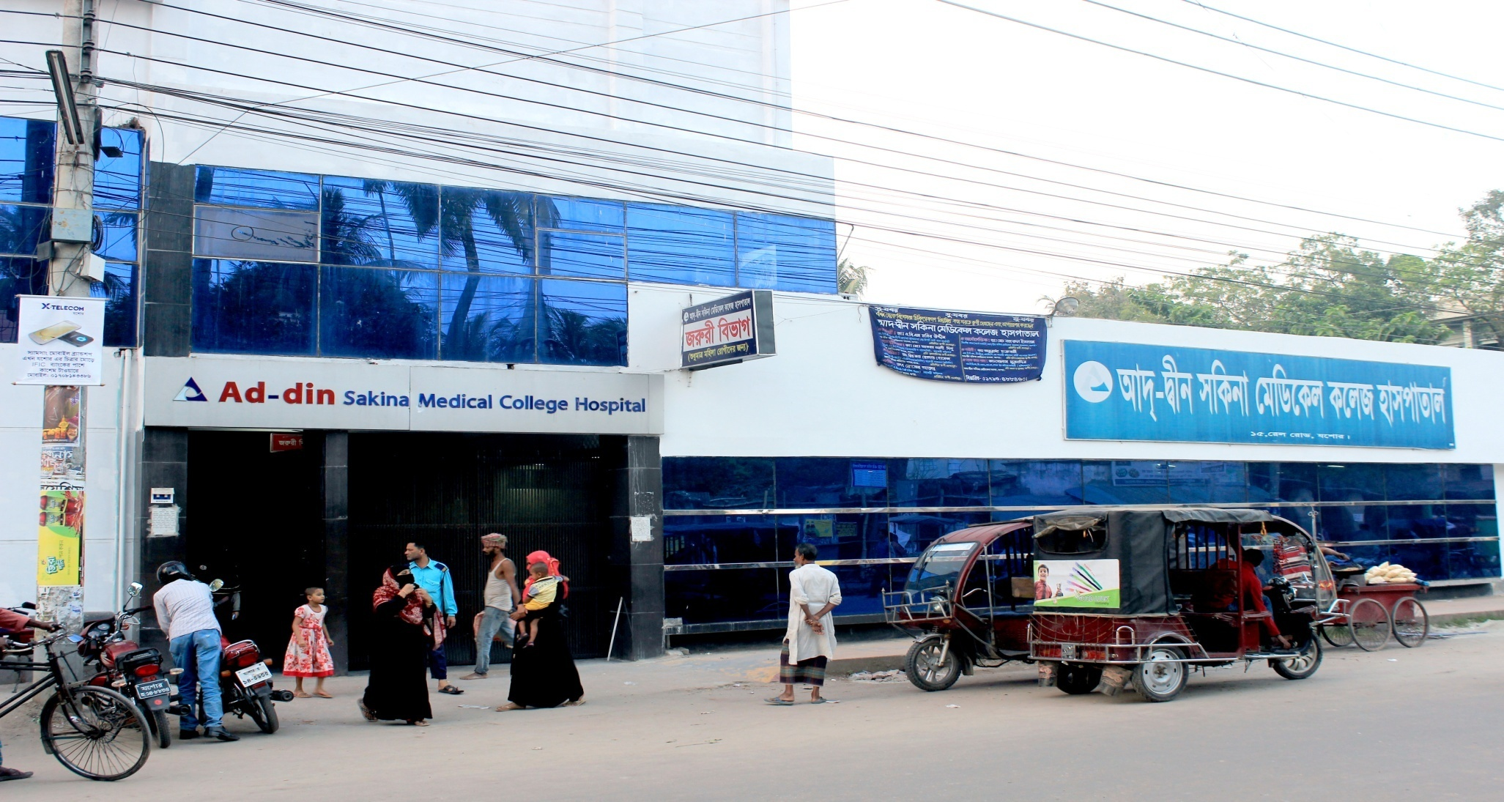
Ad-din Sakina Women’s Medical College Hospital

Slide 2
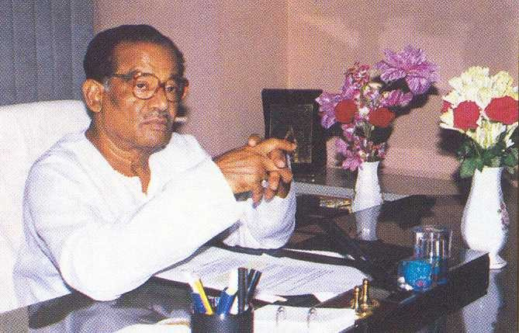
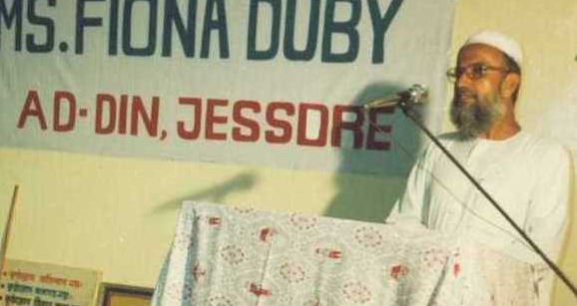


Founder of Ad-din
Late Sheikh Akijuddin
Founder Chairman
Established Ad-din out of corporate social responsibility.
Founder of Akij Group with 20 business units.
Late Prof. Sharif Hossain
Founder of lot of social organizations, educationist, recipient of Ekushe Padak.
Dr. Sheikh Mohiuddin
Founder Executive Director

Slide 3


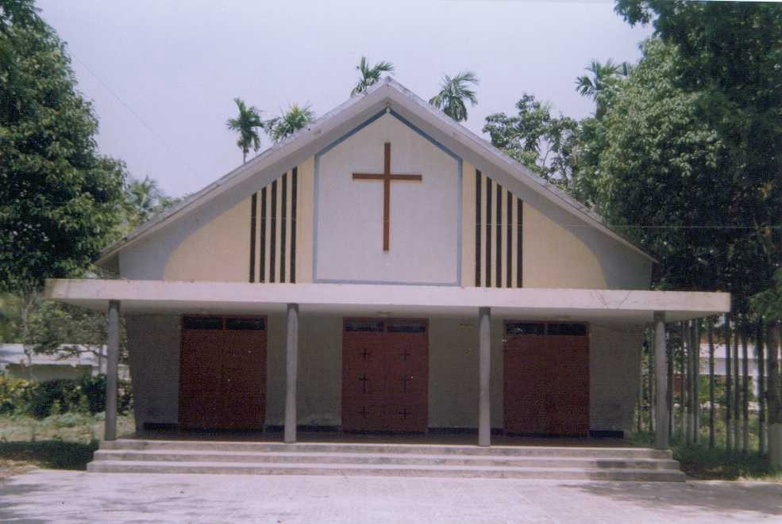
Core Values
To respect and take care of the cultural & religious values of our country as a part of development

Slide 4



Ad-din Sakina Medical College Hospital
Background
Ad-din Hospital started at 5 April 1985 in Kholadanga, Jashore with the aim of providing standard health service specially to the women, children and others at minimum cost .
Ad-din Sakina Women’s Medical College started at 2011 in Jashore.
Ad-din Women’s Medical College Hospital Started 1 November, 1997 in Dhaka.
Ad-din Nursing Institution started in 1997

Slide 5




Ad-din Hospitals
Ad-din Medical College Hospital, Dhaka
Estd. 1 Nov 1997
500-Bed
Ad-din Sakina Medical College Hospital, Jessore
Estd. 4 April 1985
300-Bed
Ad-din Akij Medical College Hospital, Khulna
Estd. 8 Feb 2013
500-Bed:.
Bashundhara Ad-din Medical College Hospital, Keraniganj, Dhaka
Estd. 25 Feb 2012
300-Bed.
Ad-din Hospital, Kushtia
Estd. 1 Nov 1999; 100-Bed
Ad-din Barrister Rofique-Ul Huq Hospital, Postogola, Dhaka
Estd. May 2017; 300-Bed

Slide 6



Nursing Institutes
Ad-din Nursing Institute, Jessore
Estd. Aug 1997
Fatema Nursing Institute, Dhaka Estd. Jul 2006
Safina Nursing Institute, Kushtia Estd. Sept 2005

Slide 7
Academic activities
Under graduate level
Intern’s Doctor’s Training : morning session, case presentation, monthly mitting , discursion on referred case, Teaching according to log book.
5th year MBBS Class
4th year MBBS Class
3rd year MBBS Class
Nursing Training
Research study :
  Wound infection
  PROM
  IUD

Slide 8
Organogram of Gyne&Obs Department 0f
Ad-din Sakina Medical College Hospital
Professor | Professor | Associate Professor | Assistant Professor | RS | Registrar | Assistant Registrar
Dr. Bodrunnesa | Dr. Torun Khanti Ghosh | Dr. Nasreen | Dr. Saleha Khatun | Dr. Shila Poddar | Dr. Sumaya Sharmeen | Dr. Tonni Moni
Dr. Hasanuzzaman | Dr. N.B Goldar | Dr . Md. Emdadul Haque
Dr. Rabiul Islam

Slide 9
Performance of gynae and obst Department from 2010-2021(Jan-Nov)
Year | Total IPD Patients | Total OPD Patients | Gynae Patients | ANC | PNC | FP | C/S | Delivery | Total Delivery | DE&C | Gynae OT
2010 | 5408? | 55710 | 7802 | 28161 | 6765 | 3516 | 2715 | 577 | 3292 | 91 | 21
2015 | 7807? | 84682 | 8105 | 25249 | 6460 | 3860 | 2879 | 606 | 3485 | 198 | 40
2018 | 10182? | 95187 | 9779 | 25325 | 5992 | 3376 | 3446 | 616 | 4062 | 446 | 88
2019 | 10783? | 98637 | 9362 | 24117 | 6217 | 3412 | 3336 | 826 | 4162 | 326 | 67
2020 | 8565? | 75003 | 6749 | 21673 | 5697 | 3315 | 3213 | 654 | 3867 | 298 | 64
2021 (Jan-Nov) | 7636? | 64332 | 7180 | 15641 | 5534 | 391 | 2621 | 430 | 3051 | 329 | 65

Slide 10
Annual Trend of ANC Services

Slide 11
Comparison between NVD and CS

Slide 12
Types of obst patients admitted in Obs ward (Jan-Nov) 2021
Title | Number
Pregnancy with Previous C/S | 580
Pregnancy with Lower abdominal pain | 581
Pregnancy with Less fetal movement | 454
Pregnancy with PROM | 330
Pregnancy with UTI | 424
Pregnancy with Ante partam haemorrhage | 157
Pregnancy with Anemia | 943
Post Dated Pregnancy | 58
PIH | 349
True labour pain | 632
Hyper Emesis graviderum | 208
Pregnancy with Oligohydramnios | 512
Pregnancy with PUO | 87
IUD | 14
Pregnancy with Big baby | 58
Pregnancy with Breach | 34

Slide 13
Gynae operation list(Jan-Nov-2021)
Total abdominal hysterectomy | 30
Sub total abdominal hysterectomy | 2
Vaginal hysterectomy | 3
Laparotomy | 13
Ovarian cystectomy | 6
Perineal tear | 27
Biopsy | 2
Bartholin cyst | 2
Total = | 85

Slide 14

Best Performing EmOC MC Hospital in Khulna Division -2020
C-Section, NVD, Total Delivery

Slide 15
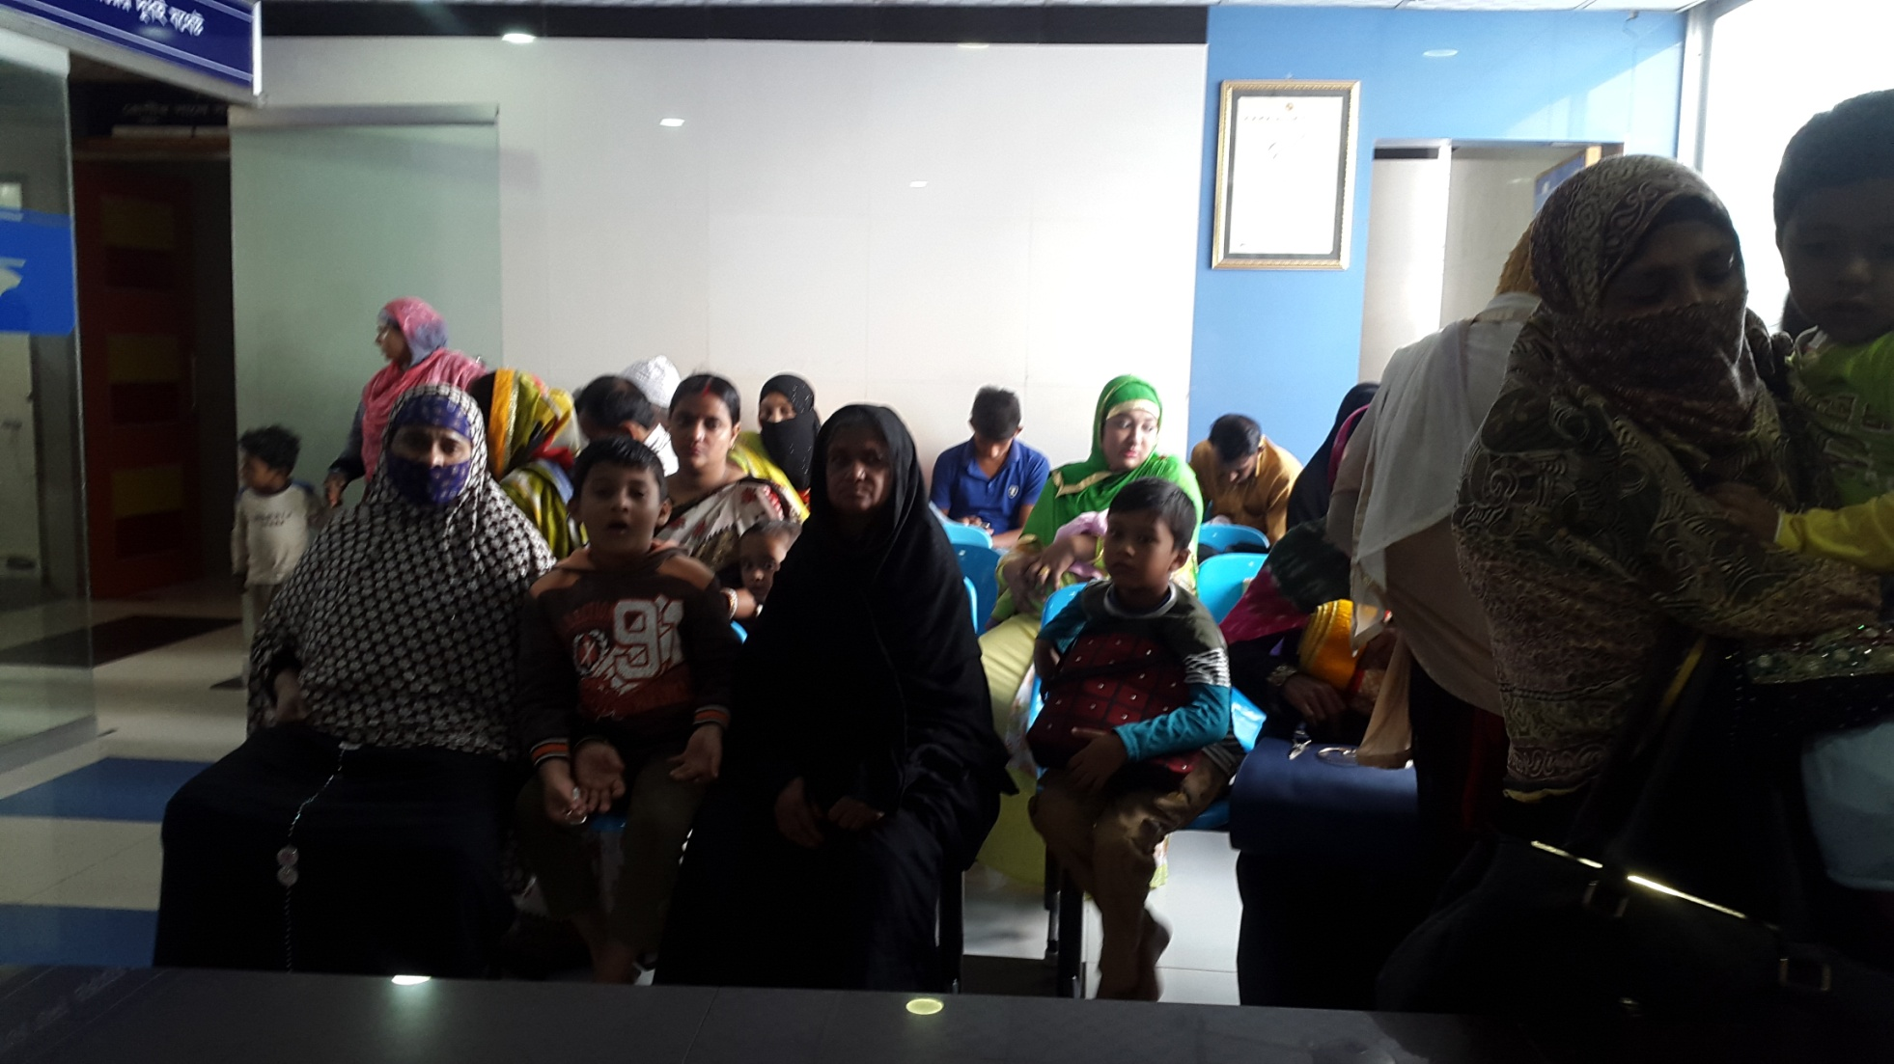
Ad-din Sakina Medical College Hospital Outdoor

Slide 16
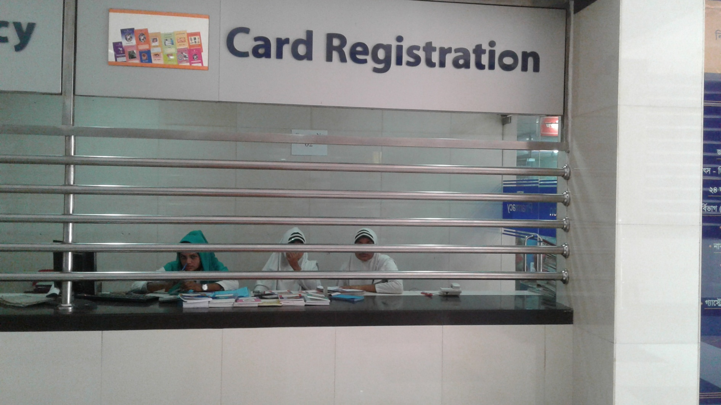
Card Registration

Slide 17
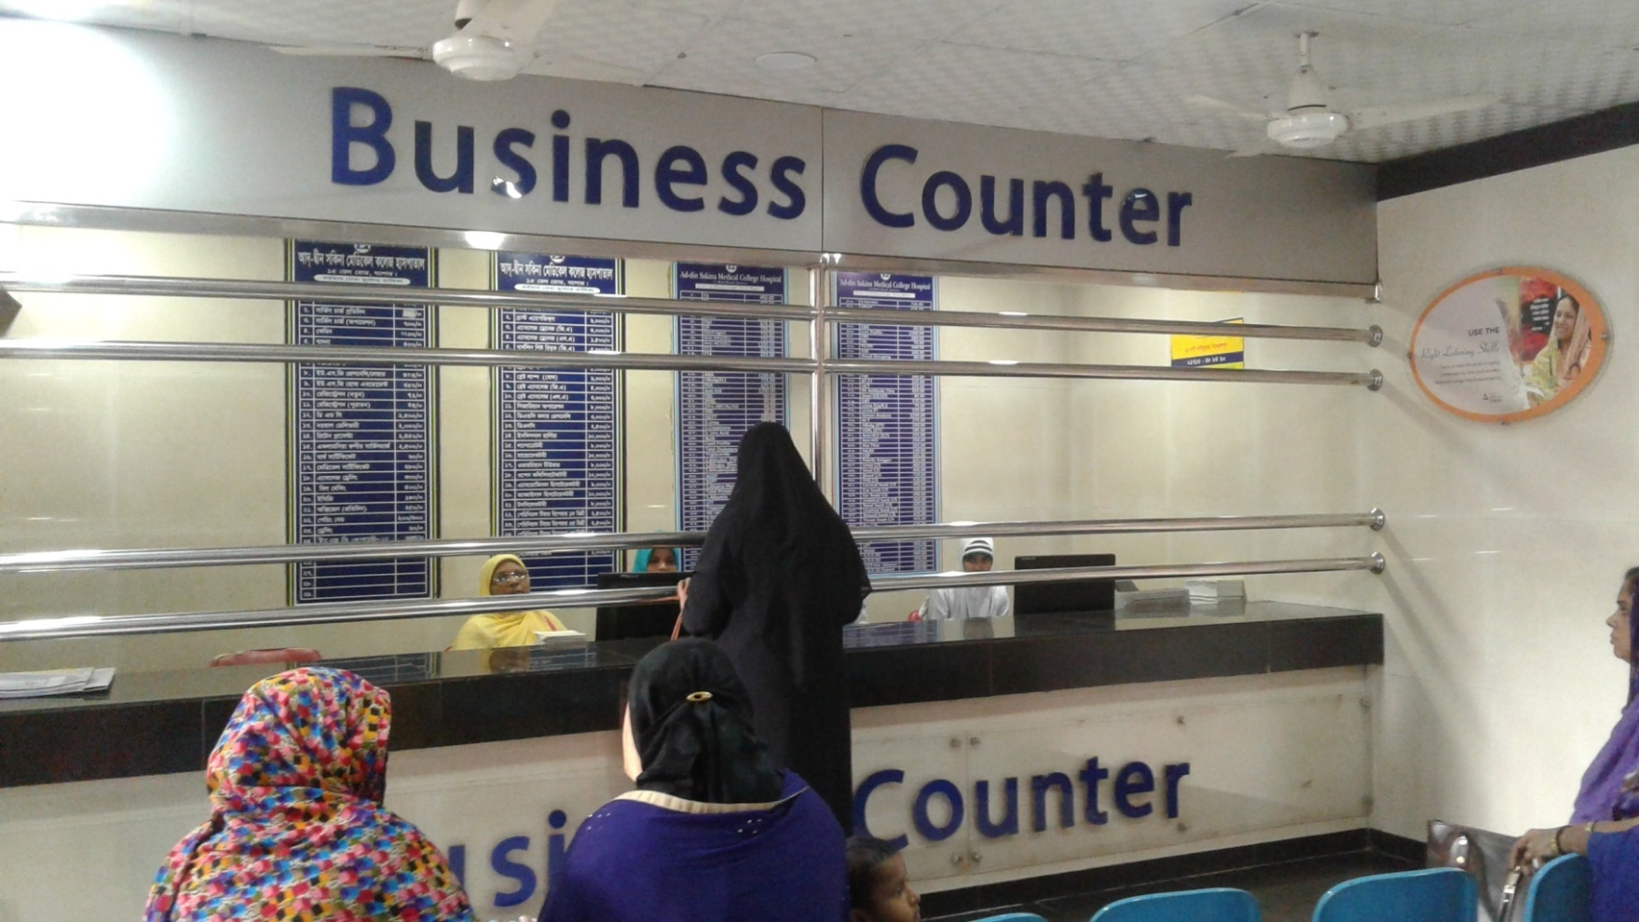
Business Counter

Slide 18
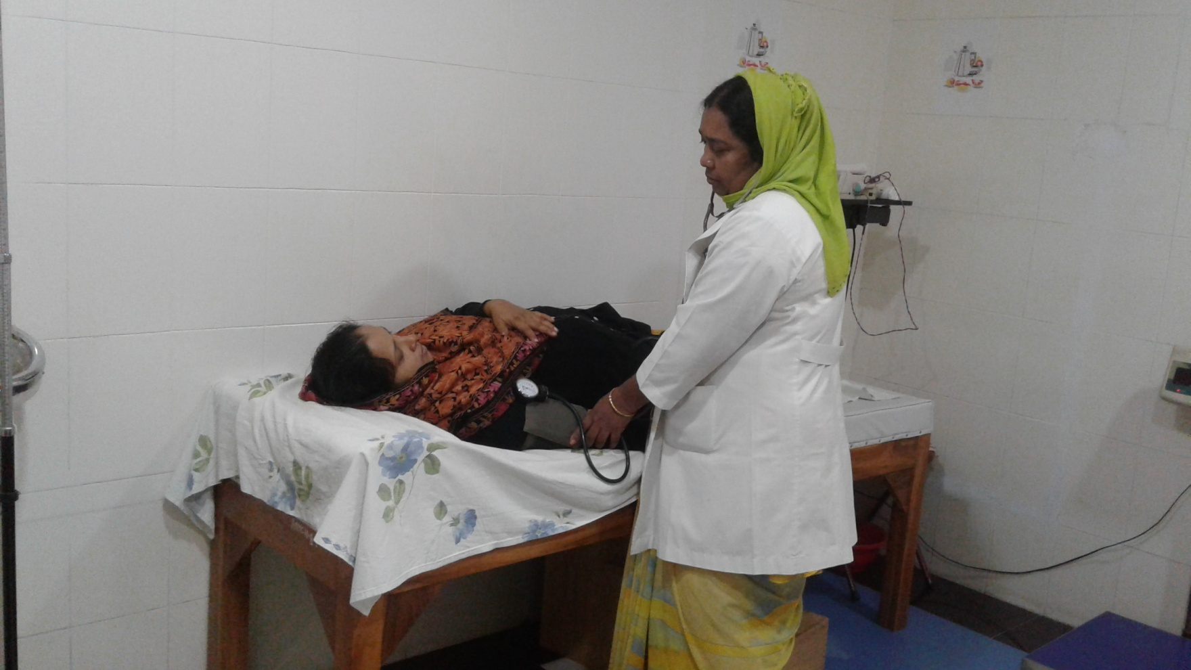
Antenatal Care

Slide 19
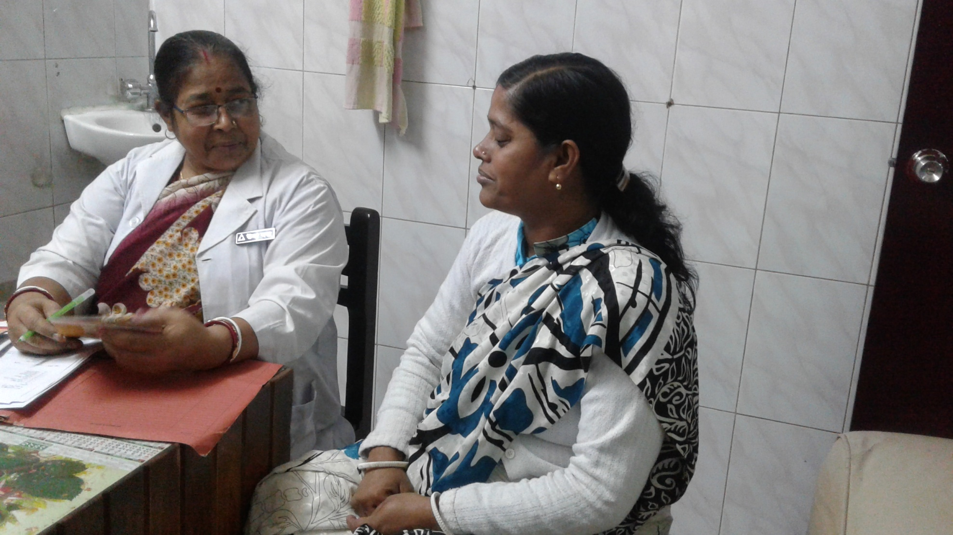
Family Planning

Slide 20
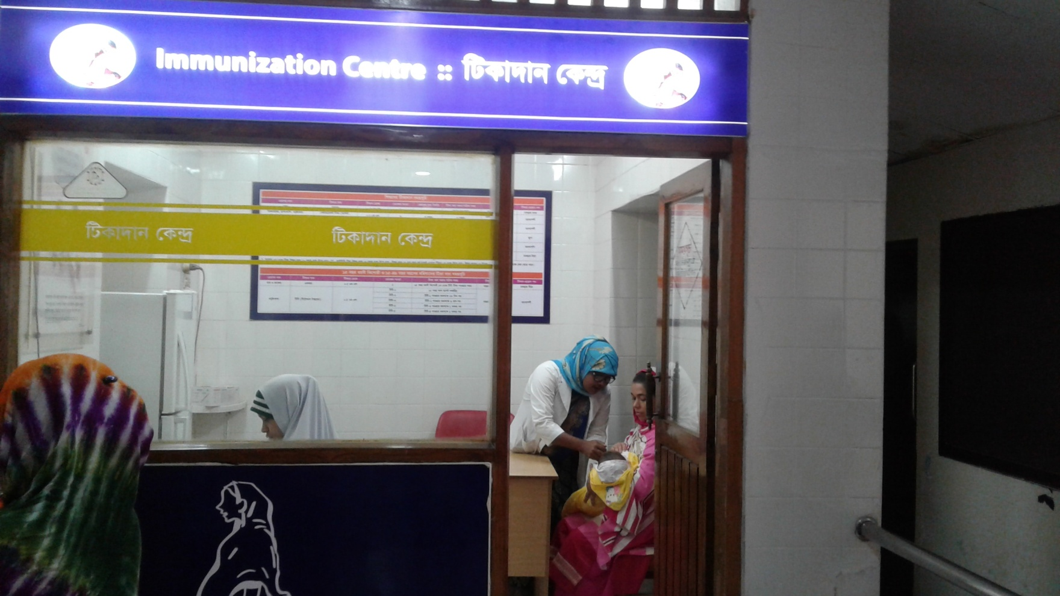
Immunization

Slide 21
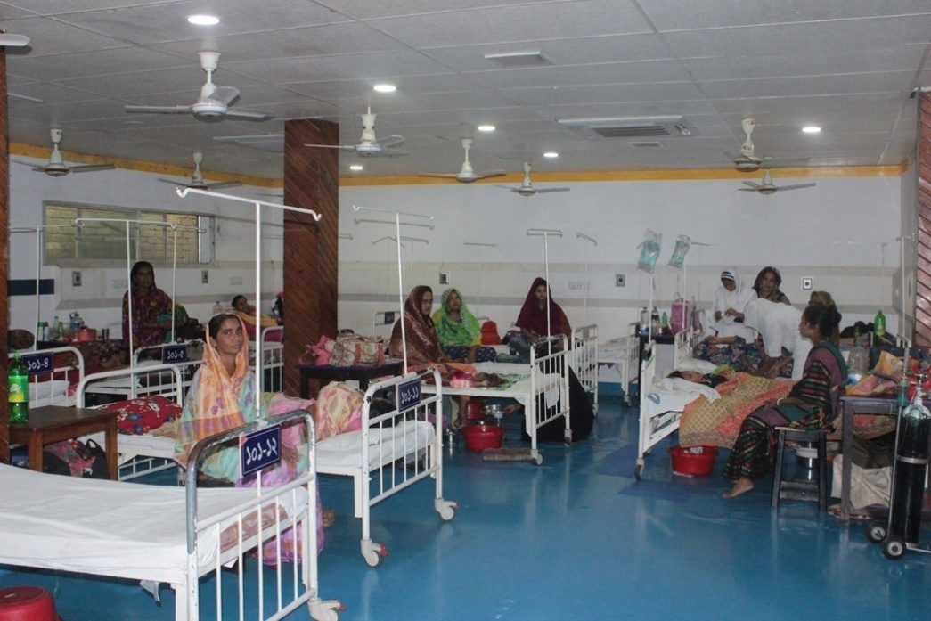
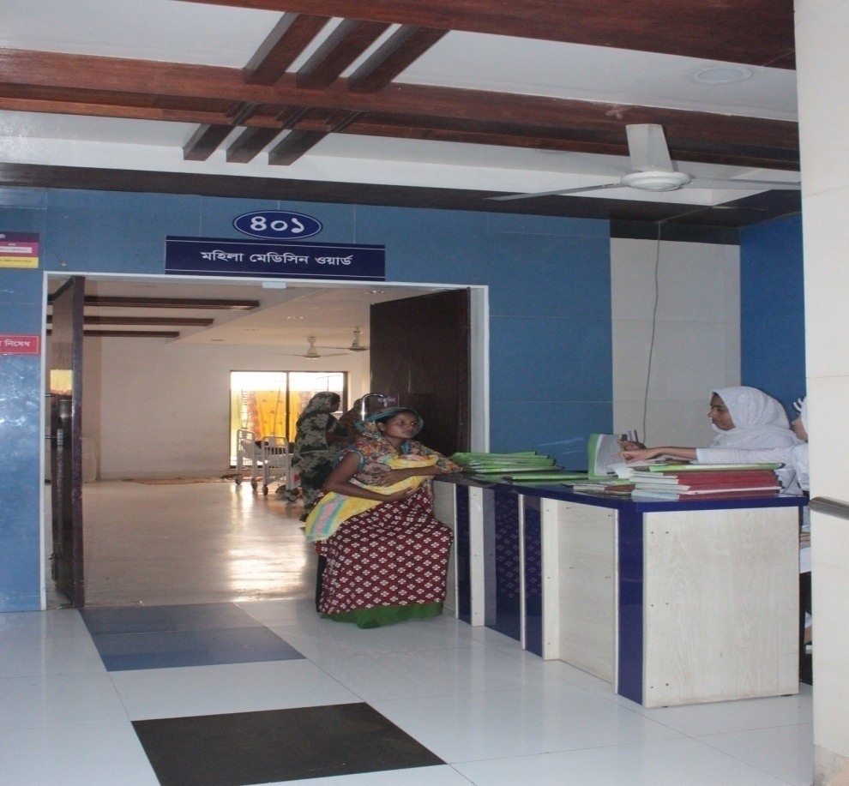
Ad-din Sakina Medical College Hospital Indoor Service

Slide 22
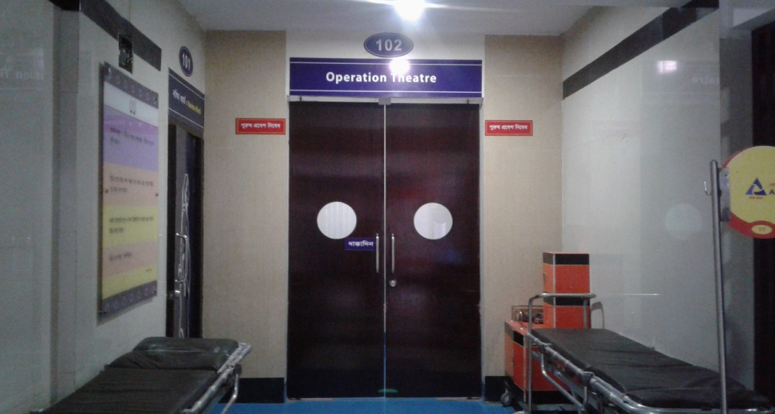
Operation Theatre

Slide 23
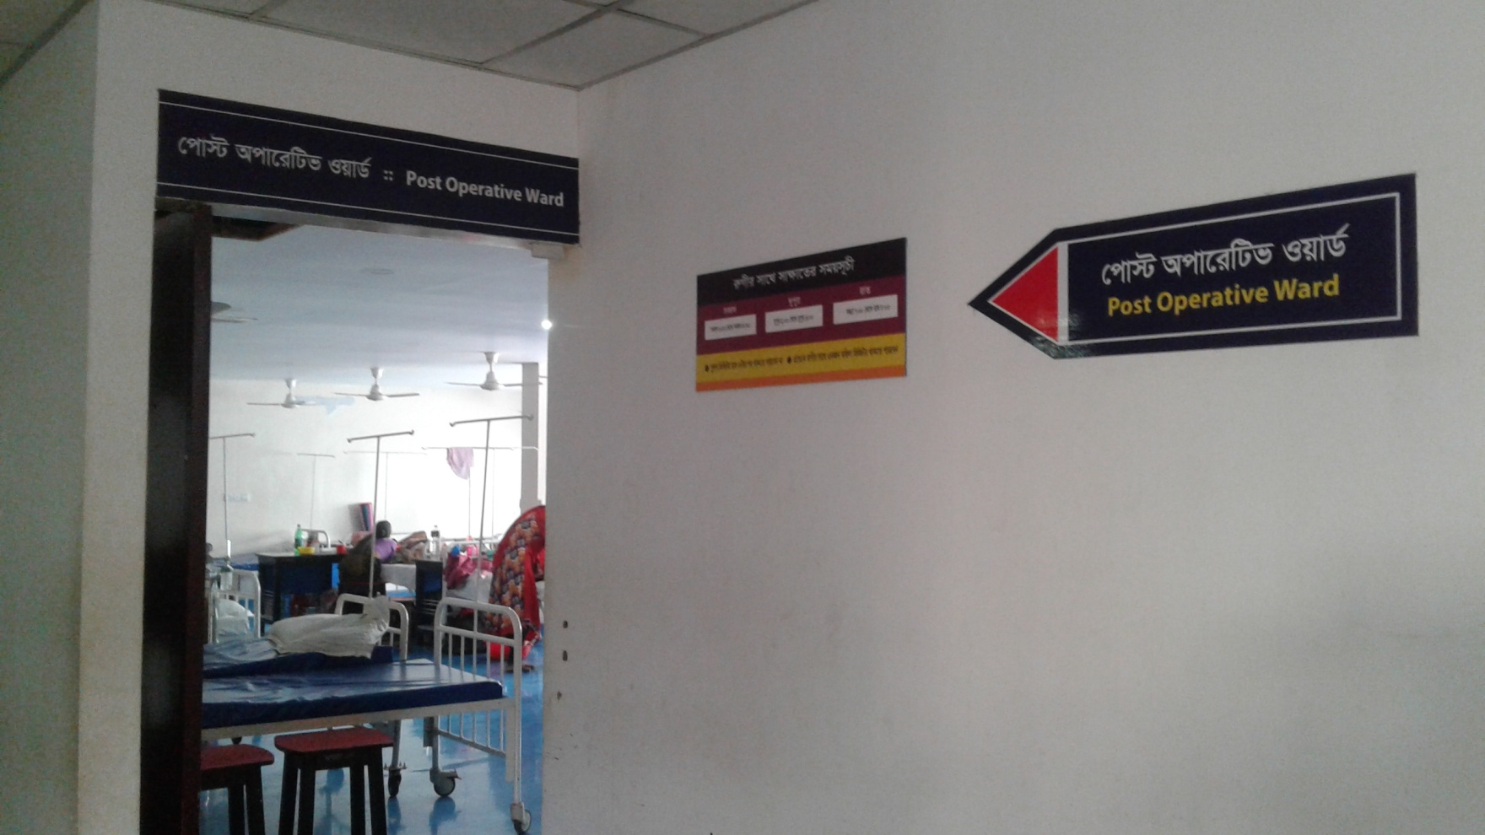
Post Operative Ward

Slide 24
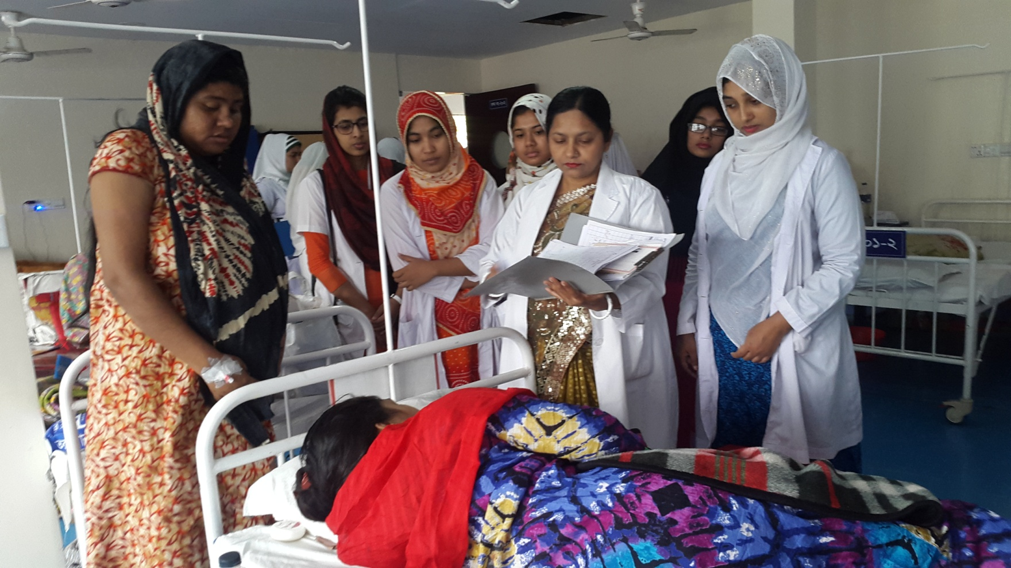
Gyane Ward

Slide 25
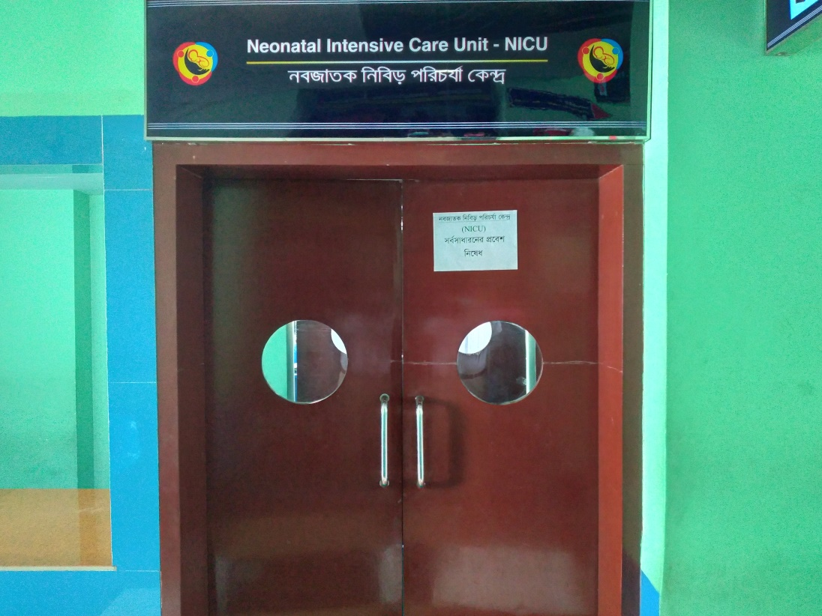
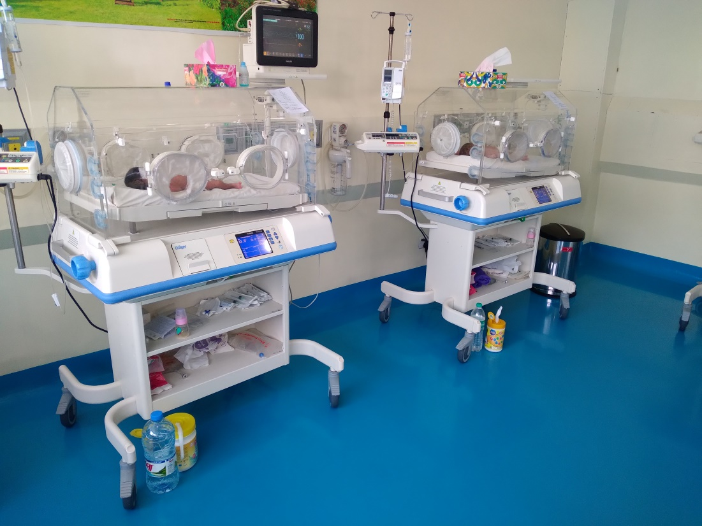
Neonatal Care Unit

Slide 26
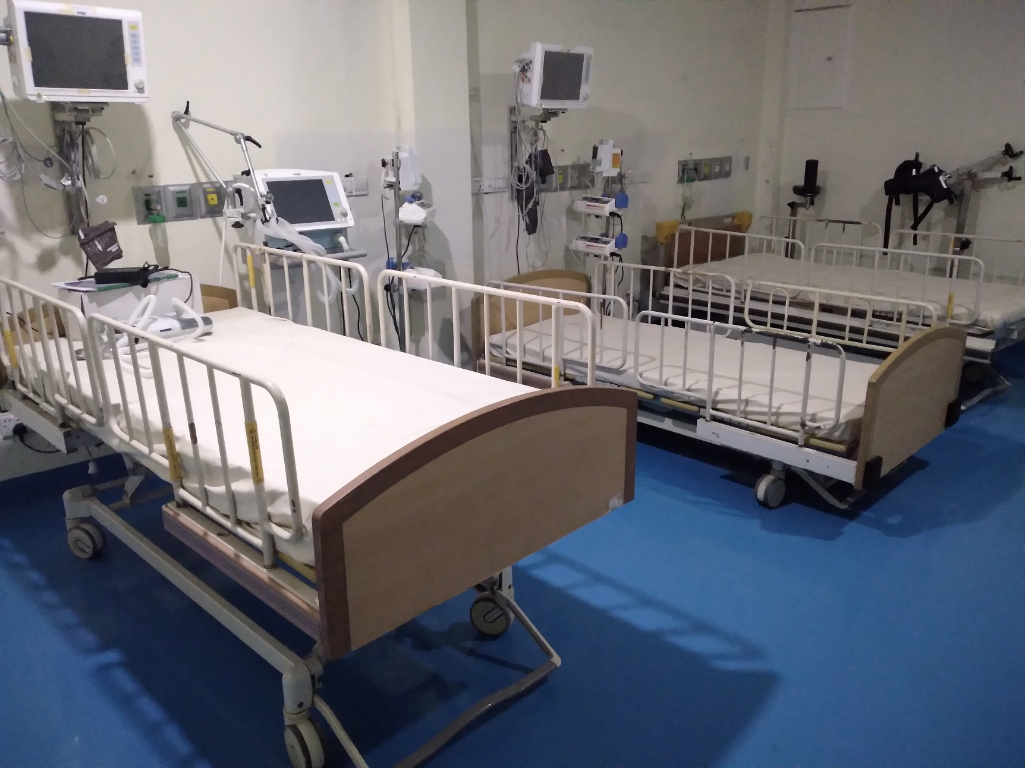
HDU

Slide 27
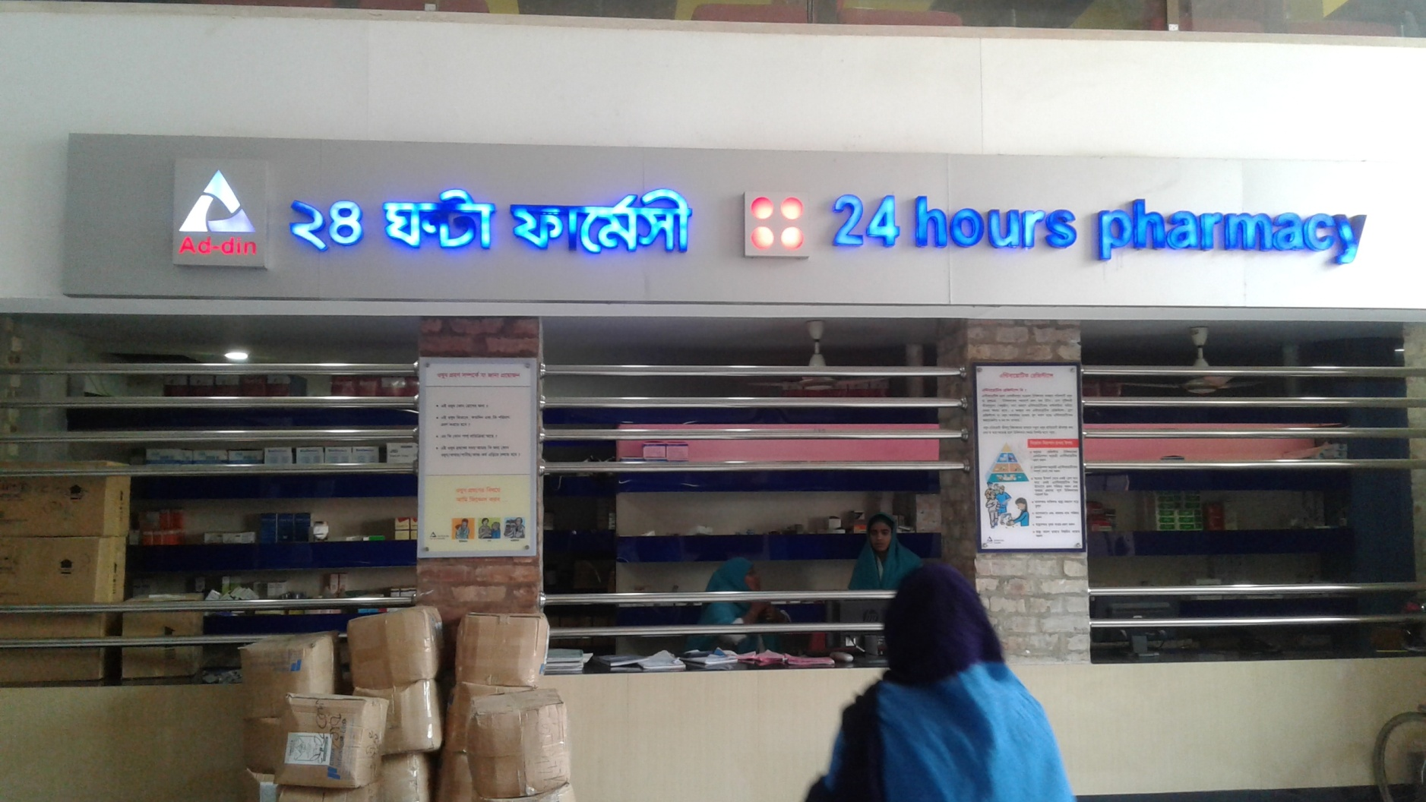
24 Hours Pharmacy

Slide 28
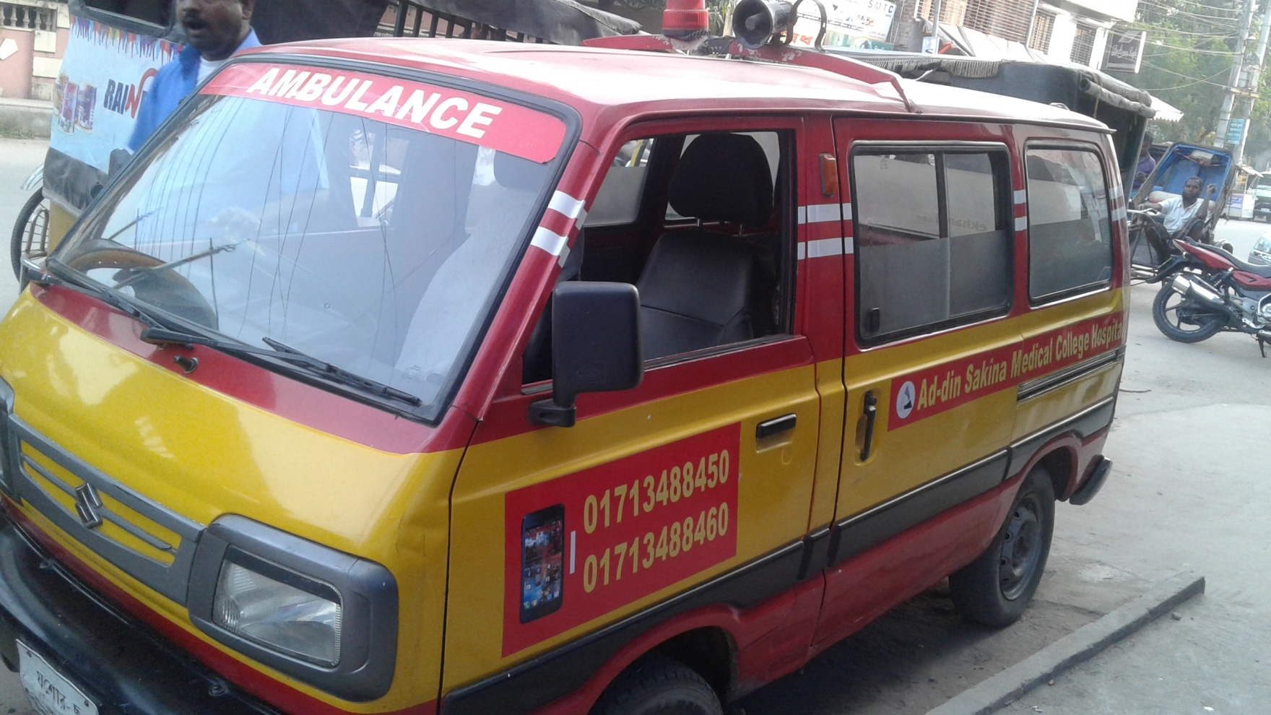
24 Hour Ambulance Service

Slide 29

Community Base Ambulance Service
12 Ambulance are serving in different area in community.
Specialty
Very low cost service (Less than 50% of market Price)
Full free at 8.00pm to 6.00am for Pregnant Mother
Easy & Quick

Slide 30

Community Health Services
Working Area: 14 Districts
Monthly Performance
Community Midwife | 98
Satellite clinic held | 2156
Average ANC | 20000
Average PNC | 3300
Pathological Test | 26000
General Patient | 19500
Average Growth Monitoring (0-3 Yrs) | 12300
Refer to Hospital | 2500
Picture of Satellite Clinic

Slide 31

Fistula Care Project
Awareness Development Training
Patient Screening
Treatment 223
Rehabilitation 61
All Services are free of cost

Slide 32
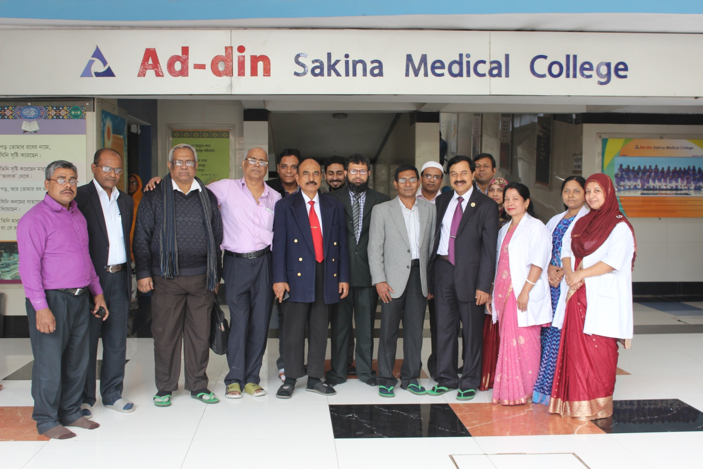
Doctor's & Manager's of Ad-din Sakina Medical College Hospital

Slide 33

Thank You All

